Slide 1
Chaos Theory Explored Through Double Pendulums

Slide 2

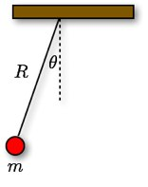
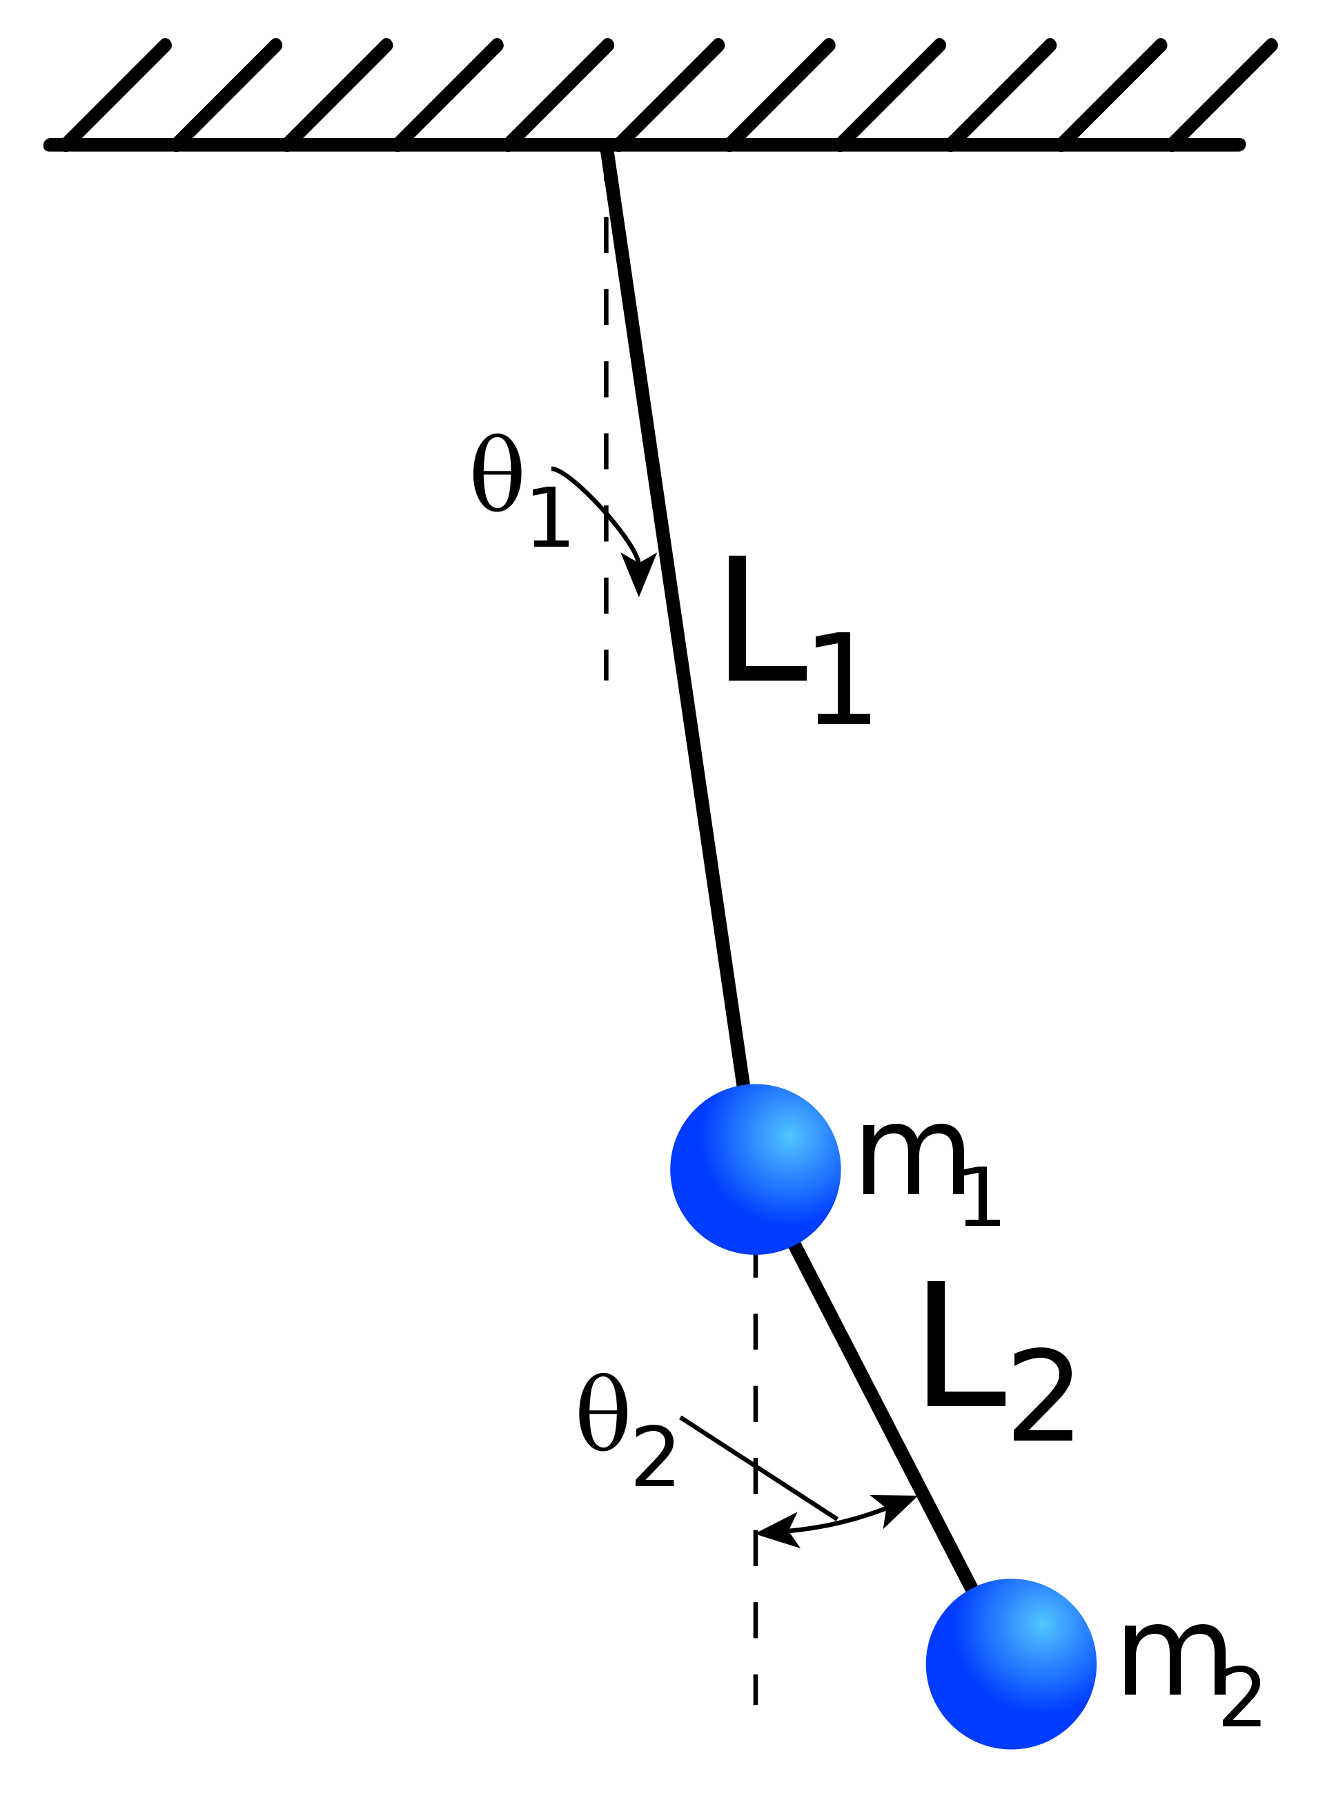
Background
Fig. 1 this picture shows a simple pendulum and all its parameters
Simple pendulums
Consistent timing and spacing forever
One of the simplest dynamic systems (see Fig. 1)
Double Pendulum
Pendulum attached to the bob of another pendulum (see Fig. 2)
Two double pendulum starting at approximately the same position can diverge
Dictated by chaos theory
Fig. 2
This picture shows all the parameters that can be changed in a double pendulum

Slide 3
Question
What conditions are required for the motion of double pendulum to be chaotic.
How big must changes in initial angles be in order to affect the system?
How do initial conditions affect the system?
Angle
How do mass and length affect the system
Mass
Length
This figure shows all the parameters of this experiment

Slide 4
Research
Double Pendulums are Chaotic Systems
Chaotic systems are governed by non-linear dynamics
Chaos theory is new in physics enabled by computers
The Butterfly Effect
States changes no matter how small will result in big changes in the system.
For example, a butterfly flapping its wings will result in a hurricane across the world

Slide 5
Hypothesis
I predict double pendulums will be chaotic no matter how small the change is.
I predict that large angles will be needed for chaos while smaller ones won’t.
I predict mass will have no effect on the system nor will length.

Slide 6
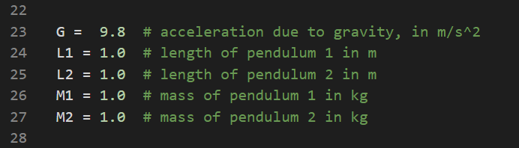
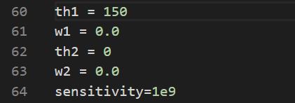
Materials
A PC, Mac or Linux system
Code
Found at https://github.com/Tharthar2/sci-fair-2020-final
Editor and Packages
Specified at GitHub in README.md
Any text editor will work (including Windows Notepad) however, Spyder is recommended if you don’t know how to install packages from PyPi
Processor 1.6 GHz or faster w/ 2+ cores
4 GB+ RAM
4 GB+ disk
X64 X86 architecture
Internet access
More info at link
Code based off https://matplotlib.org/examples/animation/double_pendulum_animated.html and https://scipython.com/blog/the-double-pendulum/
Location of mass and length values
Location of angle and sensitivity values

Slide 7
Variables
Independent
Angles
Dependent
Splitting time
Constants
Any unchanged independent variables
Mass
Length
Variation factor
Critical angle
Coding environment
Hardware (Out-of-the-box HP Pavilion Laptop 15-cs1xxx)
Software (Windows 10, Python 3 NumPy, Matplotlib, SciPy)

Slide 8
Procedure: Software Installation Important! This Procedure for windows 10. all experiments assume this software is in use
Install editor and packages
For Spyder https://www.anaconda.com/distribution/
Select your operating system and download for Python 3.x
When done run the .exe file
Say yes and use recommended settings
If using another python editor install the latest python 3 from https://www.python.org/downloads/ and run “pip install NumPy, matplotlib, SciPy” in your terminal
Clone or download code from https://github.com/Tharthar2/sci-fair-2020-final
In git bash enter “cd [download directory]” and then “git clone https://github.com/Tharthar2/sci-fair-2020-final.git”
Test the code
Open Spyder
Hit Ctrl + O and find the file
Go to top bar hover over “Run” and hit “Profile” in the dropdown
If a window opens and runs the simulation, you did it. If not, consult GitHub issues tab for code or package documentation for packages and editor.

Slide 9
Procedure
Procedure: Changes in theta
Procedure: Critical Angle pairs
Find variable “sensitivity”. It is set to 1e1 on GitHub.
Set M1,L1,L2,M2=1 th2=th1 and th1 =90
Record how long it takes for the pendulums to diverge.
Repeat for sensitivity = 1e2, 1e3, 1e4, etc.
Eventually, the pendulums will no longer diverge. At this point, the experiment is over.
It is important to know that the last number represents the limit of your hardware, not the actual theoretical limit.
Set Mass and length values to 1.
Set th2 = th1 and th1 = 90
Adjust th1 until system becomes chaotic.
It is recommended that binary search is used; try 90 if it’s still chaotic, set to half-way between 90 and 0. If it wasn’t chaotic set to half-way between 90 and 180. do this until the borderline between chaotic and non-chaotic is found.
Repeat steps 1-3 for th2 = 0, 30, 60, 90, etc.
Repeat procedure fixing th1 instead of th2
When th1 and th2 pairs are plotted, the curve represents the border between chaotic and normal.
Any pair of points on and outside of the curve are chaotic while points inside are normal motion.

Slide 10
Procedure (cont.)
Mass
Length
Set all parameters to 1
Find the critical angle of the system
Set th1 and th2 to 90 record when the system splits into 2
Repeat for all angle ratios with numbers 1-3 e.g. m1=1,m2=2; m1=2, m 2=3; etc.
Set all parameters to 1
Adjust length the same way mass was adjusted.
Test length for critical angle
Test length for division time

Slide 11
Results: Angle variation
.
.
This plot graphs when the pendulum diverges against the variation factor. The variation factor is defined on line 62 of the code and its usage is to define the difference between the 3 pendulums an expressed as actual angle=input angle/variation factor
.
.
Angle Variation | Diverge Time
1.00E+01 | 0
1.00E+02 | 5
1.00E+03 | 10
1.00E+04 | 14
1.00E+05 | 16
1.00E+06 | 17
1.00E+07 | 20
1.00E+08 | 21
1.00E+09 | 20
1.00E+10 | 21
1.00E+11 | 20
1.00E+12 | 21
1.00E+13 | 20
1.00E+14 | 19
1.00E+15 | 19
1.00E+16 | 20
The data shows that the smaller the angle, the shorter the divergence time is until around 1e7. at this point, the simulation processes the number the same way until 1e17. After 1e17, the program doesn’t consider the angle a significant number anymore
Note: the scale is logarithmic. This was done to illustrate the data better. A linear scale would result in most of the data being on one side.

Slide 12
Results: Chaotic Angle Pairs
th2 | critical th1
-180 | 0
-150 | 0
-120 | 36.03
-90 | 56
-45 | 79
-15 | 85.09
0 | 80.01
15 | 59.34
30 | 75.1
45 | 72.89
60 | 88.72
81.5 | 60
90 | 47.85
95.03 | 30
120 | 14.76
150 | 0
155.03 | 0
180 | 0
50&0
90&0
120&0
150&0
This is the chart of angle combinations that yield chaotic results. Any pair of points in the green region will, in theory, be chaotic. Any pair of angles inside the red region will be a standard system

Slide 13
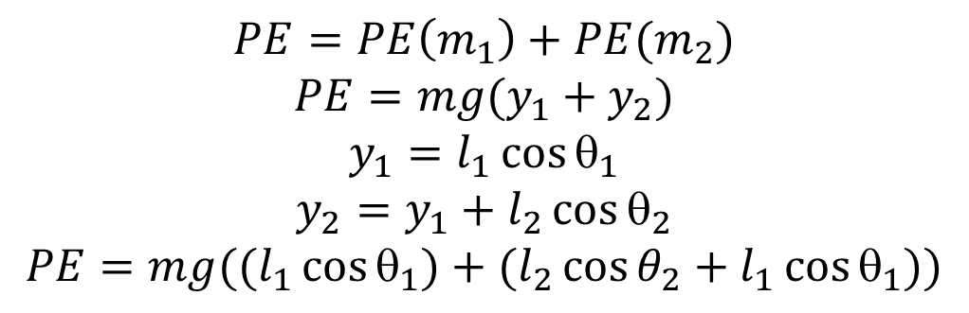
Does Potential Energy Control Splitting time?
The potential energy of all angle pairs in the previous experiment was computed and plotted against the splitting time. The data shows that there is no correlation between potential energy and divergence time.
$$PE=PE\left(m_{1}\right)+PE(m_{2})$$
$$PE=mg(y_{1}+y_{2})$$
$$y_{1}=l_{1}\cos{θ_{1}}$$
$$y_{2}=y_{1}+l_{2}\cos{θ_{2}}$$
$$PE=mg((l_{1}\cos{θ_{1})+(l_{2}\cos{θ_{2}+l_{1}{\cos{θ}}_{1}))}}$$

Slide 14
Double pendulum with two different Masses
.
This chart shows that there is no correlation between mass ratio and the critical angle. The data still showed no correlation even after averaging with 4 other trials.
.
mass 1 | mass 2 | mass ratio | inverse ratio | mass diff | inv mass diff | minimum div.
3 | 1 | 3 | 0.333333 | 2 | -2 | 53.49
2 | 1 | 2 | 0.5 | 1 | -1 | 79
3 | 2 | 1.5 | 0.666667 | 1 | -1 | 85.8
1 | 1 | 1 | 1 | 0 | 0 | 79.15
2 | 3 | 0.666667 | 1.5 | -1 | 1 | 72.56
1 | 2 | 0.5 | 2 | -1 | 1 | 60
1 | 3 | 0.333333 | 3 | -2 | 2 | 90.57
This chart shows the effect of mass difference on the critical angle. The graph is a mirrored mirror image of one side.

Slide 15
Double pendulum with two different Lengths
When length is varied, the critical angle goes down in steps of 3 data points getting more spread out as the length ratio increases.
L1 | L2 | mass ratio | mass diff | critical angle
1 | 1 | 1 | 0 | 79.15
1 | 2 | 0.5 | -1 | 100.37
1 | 3 | 0.333333 | -2 | 98.68
2 | 3 | 0.666667 | -1 | 100.47
2 | 1 | 2 | 1 | 77.17
3 | 1 | 3 | 2 | 68.15
3 | 2 | 1.5 | 1 | 80
Both patterns in length demand further investigation
This shows the mass difference plotted against the critical angle. Is shows a similar mirroring pattern to mass.
.

Slide 16
Conclusion
Speaking on the angle changes, I was incorrect in practice.
However, in theory the system should respond to any change making me correct
On the angle pairs, I was correct.
The data clearly showed that certain pairs were chaotic while other remained the same.
When it came to the mass and length, I was incorrect.
Mass and length had very interesting correlations with the critical angle.

Slide 17
Citations
“Animation Example Code: double_pendulum_animated.Py¶.” Animation Example Code: double_pendulum_animated.Py - Matplotlib 2.0.2 Documentation, 2018, matplotlib.org/examples/animation/double_pendulum_animated.html.
Asylum, The Science. “Lagrangian Mechanics: How Powerful Is It?” YouTube, YouTube, 9 July 2019, https://www.youtube.com/watch?v=MIBfKJHMWHU
Britannica, The Editors of Encyclopaedia. “Chaos Theory.” Encyclopædia Britannica, Encyclopædia Britannica, Inc., 2 Apr. 2019, www.britannica.com/science/chaos-theory#ref251589.
“The Double Pendulum.” The Double Pendulum, 2019, scipython.com/blog/the-double-pendulum/.

Slide 18
Thank You
Any Questions?

